Slide 1

High Cloud Airlines:
A Strategic
Performance Review
SLIDELY_ONLY_OFFICE_SLIDE_ID_141511757
Analysis Prepared by Group No. 5
Presented by Vaishnavi & Adwaith

Slide 2




Objective: Unlocking Operational Excellence Through Data-Driven Analysis
SLIDELY_ONLY_OFFICE_SLIDE_ID_112493251
To gain a comprehensive understanding of High Cloud Airlines' operations from 2008-2013 through rigorous data analysis.
Ultimate Goal
Areas of Investigation:
The ultimate goal is to generate actionable recommendations that enhance operational efficiency and drive profitability.
Load Factor Dynamics: Analyzing utilization trends over time.
Competitive Landscape: Identifying top carriers and market positioning.
Network & Route Analysis: Pinpointing popular routes and demand patterns.

Slide 3


Our analysis is rooted in a well-defined scope and a robust, multi-step methodology
SLIDELY_ONLY_OFFICE_SLIDE_ID_188736421
Analytical Scope
Core Methodology
Load Factor & Capacity Utilization
Passenger Preferences & Carrier Choice
Popular Routes & Network Flow
Overall Operational Efficiency
1. Data Exploration & Cleaning: Analysis is based on Main data file & other supporting files, which were cleaned to treat missing values, special characters replacement, and other data quality issues.
2. Data Modeling & Merging: The cleaned datasets were merged using Power Query to establish connections between disparate data points and enable KPI extraction.
3. Data Visualization & Analysis: Visual dashboards were created to highlight flight routes, passenger demographics, and financial performance, allowing for clear identification of trends and strategic insights.

Slide 4
SLIDELY_ONLY_OFFICE_SLIDE_ID_172534790
A look at the year-over-year operational efficiency of the airline.

Slide 5
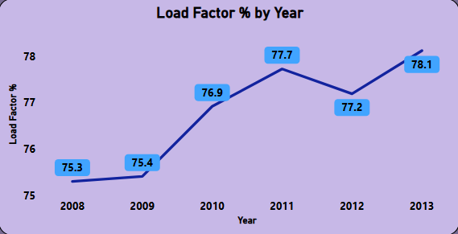



Yearly load factor shows growth peaking at 76.9% in 2010 before stabilizing
The airline's capacity utilization saw a period of growth from a stable base, before settling at a new, higher baseline, indicating maturing operations.
SLIDELY_ONLY_OFFICE_SLIDE_ID_136393332
Performance Breakdown
Yearly Lad Factor %
2008-2009: Stable Foundation - Load factor remained steady at 75.3% (2008) and 75.4% (2009), reflecting a consistent baseline for operations.
2010: Peak Performance - A noticeable jump to 76.9%, marking a significant improvement in efficiency compared to prior years . Which highlights improved seat utilization and stronger capacity management.
2011-2013: New Equilibrium - The airline sustained higher performance, with load factors stabilizing around the 77–78% range:
2011: 77.7%
2012: 77.2%
2013: 78.1%

Slide 6
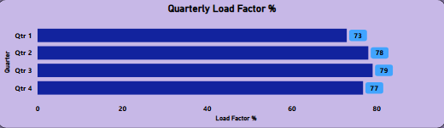
Quarterly load factor shows growth peaking at 79% in Q3 before stabilizing
The airline’s quarterly load factor shows a growth trajectory peaking in Q3, followed by stabilization at a higher baseline (77–79%). This reflects maturing operations with opportunities to fine-tune demand stimulation in weaker quarters and optimize profitability in stronger ones.
SLIDELY_ONLY_OFFICE_SLIDE_ID_136393332
Performance Breakdown
Yearly Lad Factor %
🌱
Q1: Lowest load factor at 73%, representing the seasonal trough.
Q2: Strong reboundto 78%, showing recovery and rising demand.
Q3: Peak performance at 79%, the highest utilization of the year.
Q4: Slight dip to 77%, but still above the Q1 baseline, indicating stability.
📈

Slide 7
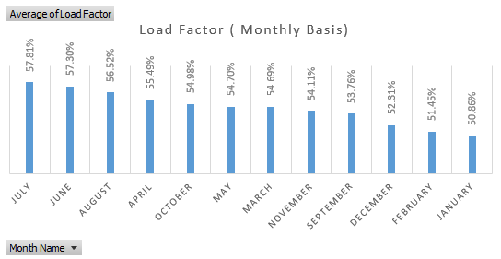
The monthly load factor shows seasonal peaks in summer (57–58%) and troughs at the start and end of the year (50–52%). This pattern reflects seasonality-driven demand cycles, offering clear opportunities: stimulate demand in weaker months and maximize profitability during peak periods.
SLIDELY_ONLY_OFFICE_SLIDE_ID_136393332
Performance Breakdown
☀️
Summer Months (June–July–August):
Highest efficiency recorded, with July peaking at 57.81%, followed by June (57.39%) and August (56.52%). This reflects strong seasonal demand.
Spring & Autumn (April, May, October):
Mid-range performance between 54.7%–55.5%, showing moderate utilization.
Year-End & Early Year (January–February–December):
Weakest efficiency observed, with January at 50.86%, February at 51.45%, and December at 52.31%, highlighting seasonal troughs.
Other Months (March, September, November):
Slightly below mid-range, between 53.7%–54.7%, indicating softer demand compared to summer peaks.
Yearly Lad Factor %
🍂
❄️
📉

Slide 8
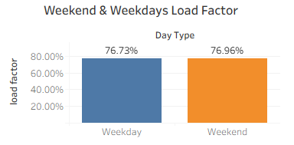
The Weekday / Weekend Load factor
SLIDELY_ONLY_OFFICE_SLIDE_ID_136393332
Performance Breakdown
📅
Weekdays: 76.73% load factor.
Weekends: Slightly higher at 76.96%, showing marginally stronger demand
The load factor is little bit more during the weekend compared to the weekday. This disparity strongly suggests that the airline's traffic is slightly heavy reliant on business travelers, regular commuters or leisure travelers, whose travel is concentrated within the traditional work week and can reach the destination during weekend.
🎉

Slide 9
SLIDELY_ONLY_OFFICE_SLIDE_ID_178526236
Benchmarking performance against other
carriers and understanding market share.

Slide 10
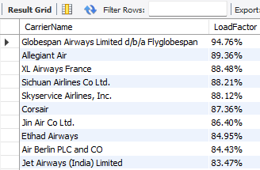
Top-tier carriers achieve 90% load factor, highlighting a significant performance gap
SLIDELY_ONLY_OFFICE_SLIDE_ID_180093995
While a few carriers operate at near-full capacity, a clear gap exists, presenting an opportunity for others to enhance efficiency.
Key Insights
Leadership Tier: Four carriers—Globespan Airways, Alegiant Air, XL Airways & Sichuan Airlines set the industry benchmark with an impressive 90% load factor.
Performance Opportunity: A distinct gap of up to 11 percentage points separates the leaders from the lower end of the top 10 Globespan Airways leads with 94.76%, far above industry averages.
The overall range of 83–94% reflects strong operational discipline across carriers

Slide 11
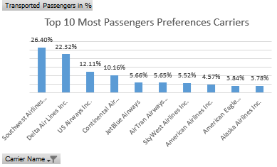
Southwest Airlines dominates passenger volume, capturing a massive 26.4 % passengers preference.
SLIDELY_ONLY_OFFICE_SLIDE_ID_167845650
The market is highly concentrated, with Southwest Airlines standing out as the clear passenger preference by a wide margin.
Key Insights
Clear Market Leader: Southwest Airlines about (26.4%) and Delta Air Lines (22.3%) which dominate, together accounting for nearly half of all passengers.
Significant Disparity: The top 4 carriers control over all 70% of the market compare to lower bottom carriers, showing a highly concentrated industry.

Slide 12
SLIDELY_ONLY_OFFICE_SLIDE_ID_113716021
Analyzing flight patterns, popular routes, and travel
behavior to optimize connectivity and service.

Slide 13
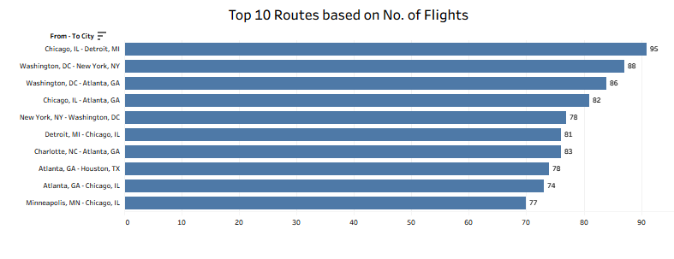


The Chicago–Detroit Route leads a highly concentrated domestic network
SLIDELY_ONLY_OFFICE_SLIDE_ID_180399599
Network Insights
The busiest route is Chicago–Detroit, followed by Washington–New York and Washington–Atlanta.
Notice that Atlanta appears in 5 of the top 10 routes, confirming its role as a major hub.
Some city pairs operate in both directions like Chicago-Detroit and Washington-New York indicating balanced demand and opportunities for round-trip pricing strategies.
Beyond the top 10, there are growth opportunities in emerging city routes.

Slide 14
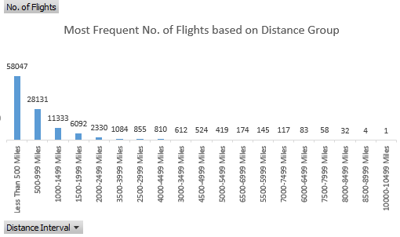
Demand is heavily skewed towards short-haul flights under 500 miles
SLIDELY_ONLY_OFFICE_SLIDE_ID_160028510
Travel patterns show a clear preference for shorter journeys, with a steep drop-off in flight volume for longer distances.
Key Observations
📍
Dominant Segment: Short-haul flights (< 500 miles) are by far the most common, accounting for over 58,000 flights.
Sharp Decline: Flight volume drops sharply for distances over 1,000 miles, suggesting that factors like cost, time, or competition from other transport modes become significant deterrents.
📍

Slide 15

SLIDELY_ONLY_OFFICE_SLIDE_ID_179385778
DASHBOARD SNAPSHOT

Slide 16
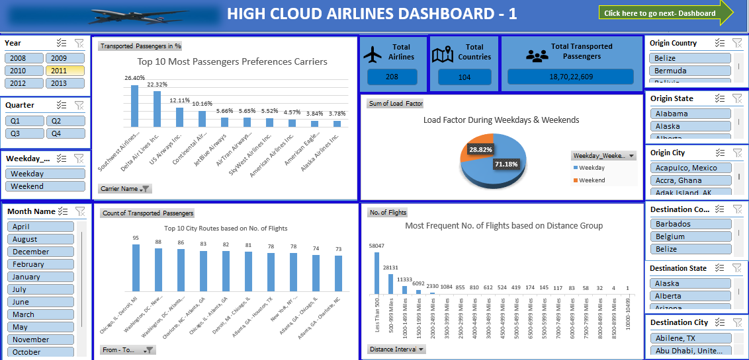
EXCEL

Slide 17
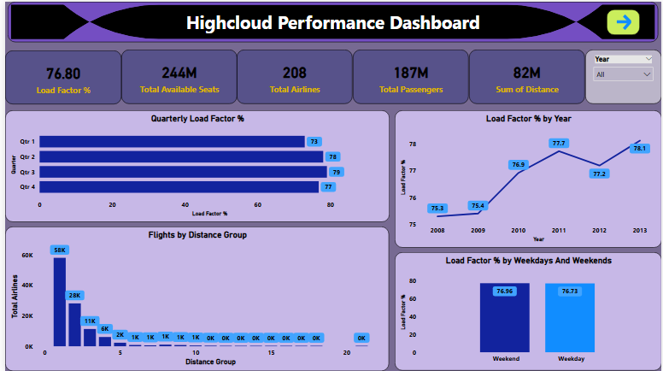
POWER BI

Slide 18
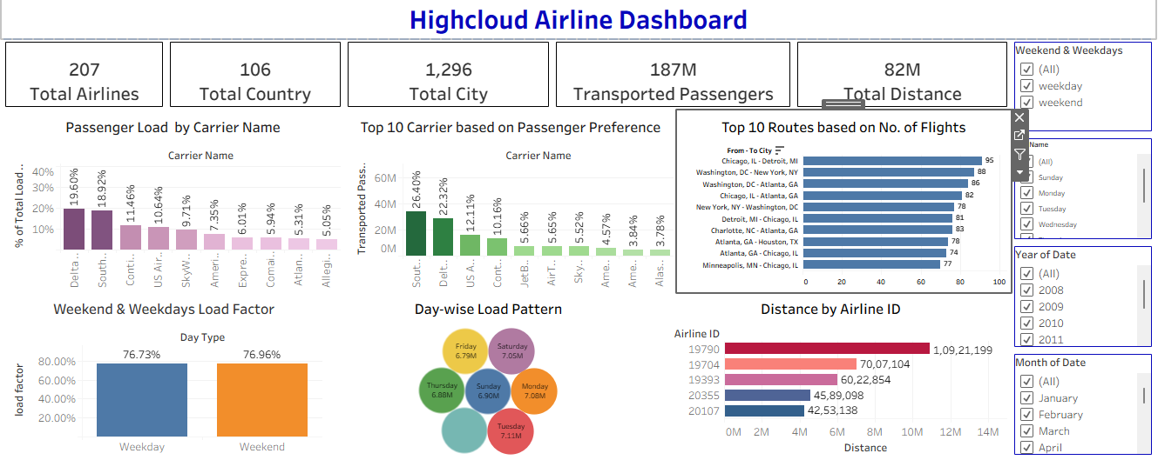
TABLEAU

Slide 19
SQL QUERY OUTPUT

Slide 20


Synthesizing our analysis into key insights for strategic planning
SLIDELY_ONLY_OFFICE_SLIDE_ID_156828726
Our analysis of the 2008-2013 operational data reveals three core areas of opportunity that can inform future strategy and drive performance improvements.
1. Route & Network Optimization
2. Load Factor Enhancement
3. Strategic Carrier Partnerships
Insight: Top routes and flight distances reveal opportunities to optimize schedules.
Action: Focus resource allocation around core hubs and short-haul corridors.
Insight: Average load factors and competitor benchmarks highlight efficiency gaps.
Action: Implement targeted strategies for increased capacity utilization.
Insight: Identification of market leaders in load factor and passenger volume.
Action: Collaborate with top carriers to enhance network performance and reach.

Slide 21


Actionable Recommendations to Enhance Efficiency and Profitability
SLIDELY_ONLY_OFFICE_SLIDE_ID_190072541
Core Strategies for Growth and Optimization
Strategic Expansion
Optimize Core Route Schedules: Focus on high-frequency routes
Optimize flight timings and aircraft size.
Goal: Maximize load factor and profitability on critical corridors.
Explore Strategic Partnerships: Expand network reach through collaboration.
Partner with dominant carriers like Southwest.
Offer seamless travel options to a wider passenger base.
Launch Load Factor Enhancement Program:
Implement dynamic pricing strategies.
To provide promotional offers for underperforming routes and non-peak times.

Slide 22
SLIDELY_ONLY_OFFICE_SLIDE_ID_179385778
Thanks
By Group No. 5

